Slide 1
Weather Station
By: Ben Jackson

Slide 2
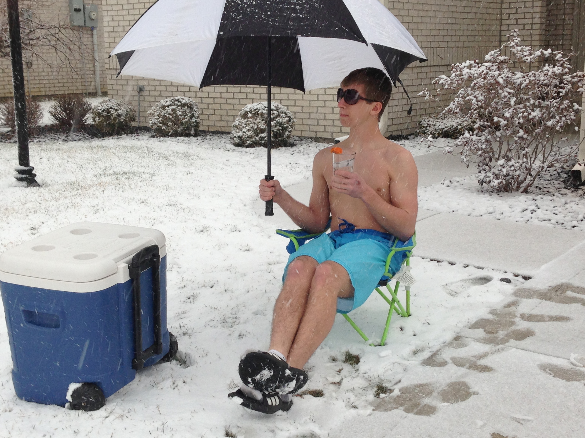
Ever feel like this kid?
Notes:
So the reason I wanted to create my own weather station was because I was tired of feeling like this… For me I would check the weather before I got out of bed and then decide what I should wear for the day. So because of this this sometimes I would wear too much clothing or not enough clothing for the day and would be uncomfortable for half the day.

Slide 3
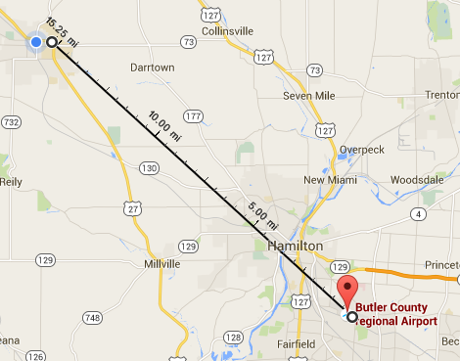
Closest Weather Broadcasting Station
Most weather applications use weather data from airports. The closest airport that gives weather data is Butler County Regional Airport, which is 15.25 miles away.

Slide 4
My Personal Weather Station (MPWS)
Features:
Current Temperature
Current Humidity
Tells the user if it’s night, dawn or dusk, and day
Suggests what one should wear when leaving his/her house

Slide 5
How it works
This embedded system uses data gathered from sensors connected to an arduino where it forms calculations to figure out information about the current weather. Finally the arduino sends the data through an ethernet shield to a router, where it sends it off to a computer via LAN (Local-Area Network).

Slide 6
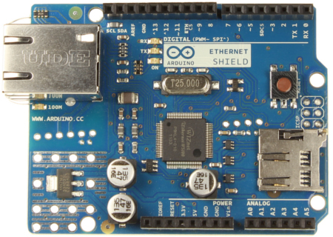
Ethernet Shield
The Ethernet shield allows an arduino to connect to the internet.
It uses Digital Pins 10, 11, 12, and 13, also pin 4 for the SD card slot.

Slide 7
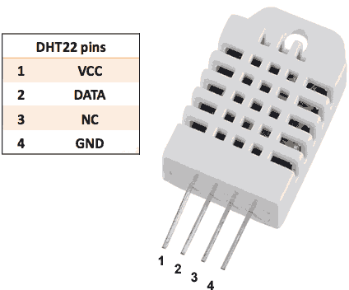
DHT Sensor
The DHT22 sensor measures Temperature and Humidity and throws back a digital signal so no need for an analog input.
Luckily Adafruit wrote a library for this sensor, so using this sensor was easy to do.
-Con: This is a slow sensor, meaning you have to wait at least 2 seconds for the sensor to throw another value back.

Slide 8
Connecting to a router
Connecting the arduino to the internet was complicated.
MAC Address (Media Access Control)
IP Address Assignment - Dynamic Vs Static
Learning HTML (Hyper Text Markup Language)
Adding HTML to Arduino code
Pray that the internet gods are on your side.

Slide 9
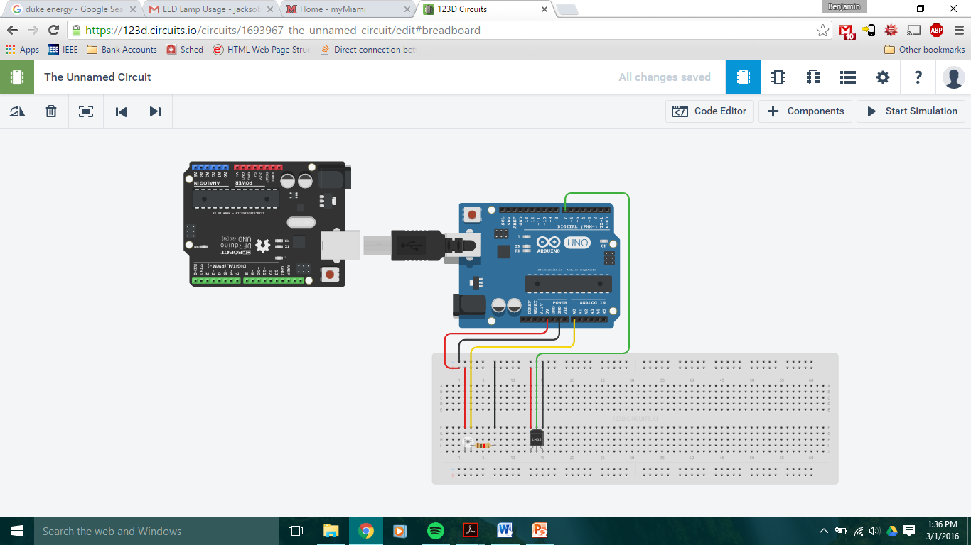

Slide 10
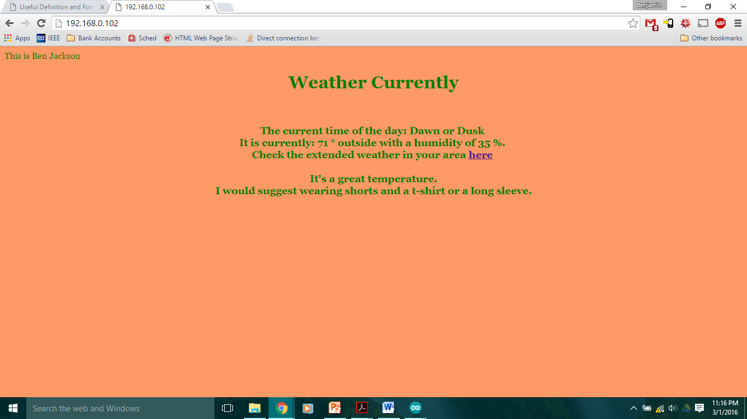

Slide 11
Cost
Arduino - $35.00
Arduino Ethernet Shield - $29.99
DHT22 Sensor - $9.50
Light Sensor - Free!
Ethernet wire - $5.00
Router - $45.00
TOTAL COST = $124.49

Slide 12
Long Term Goals
Tie this weather station to a “Smart Home” application.
Connect to thermostat
Security monitoring
Energy efficient lighting
Control it anywhere in the world
Make it more user friendly.

Slide 13
Thank you

